Slide 1











Advanced Type Systems
Lecture 2
Programming Languages 3 (PL3)
Computer Science
2025-09-25
Rust
Python
JavaScript
Go

Slide 2
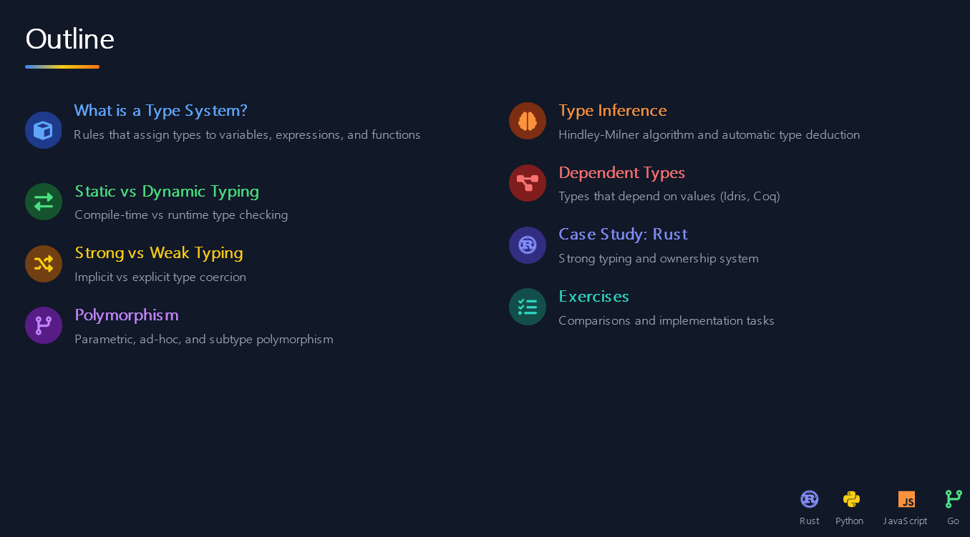

Slide 3
























What is a Type System?
A type system is a set of rules that assigns a type to various constructs within a programming language, such as variables, expressions, and functions.
Assigns Types
Prevents Errors
Enables Optimizations
Maps language constructs to types, enabling operations to be performed based on those types.
Catches invalid operations early by ensuring operations are only performed on compatible types.
Allows compilers to generate more efficient machine code by making assumptions about memory layout and operations.
How a Type System Works
Code
Type System Rules
Valid/Invalid
Optimized Code

Slide 4


















Static vs Dynamic Typing
Static Typing
Dynamic Typing
Type checking occurs at compile-time
Type checking occurs at runtime
int x = "hello"; // ERROR
x = "hello"
x = 5; # valid
Early Error Detection
Compiler catches errors
Late Error Detection
Performance
Errors appear during execution
Faster execution
Performance
Safety
Potential overhead
Strong guarantees
Safety
Examples: Rust, Java, C++
Flexibility over safety
Examples: Python, JavaScript, Ruby
Rust
Python
JavaScript
Go

Slide 5




















Strong vs Weak Typing
Strong Typing
Weak Typing
Does not allow implicit type coercion
Allows implicit type coercion
Requires explicit conversions between types
Automatically converts between types
Prevents accidental type errors
Offers flexibility but can lead to bugs
Examples:
Rust
Java
Python
Examples:
JavaScript
PHP
C
JavaScript Example (Weak Typing)
// Subtractionconsole.log("5" - 2); // 3
// Additionconsole.log("5" + 2); // "52"
string "5"
number 5
Implicit conversion
number 2
string "2"
Implicit conversion
JavaScript
Python
Rust

Slide 6








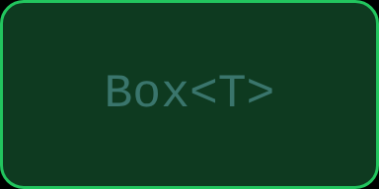
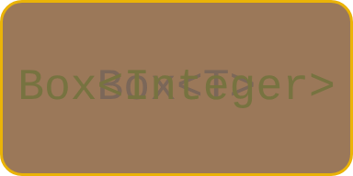
Polymorphism: Parametric
Parametric Polymorphism
class
Box<T>
{
Parametric polymorphism allows functions or data structures to be written generically, operating uniformly on values without depending on their specific type.
T
value;
Box
(
T
v) {
value = v;
}
Key concept: Type variables act as placeholders, and the compiler instantiates the generic code with concrete types as needed.
T
getValue() {
return
value;
}
}
Benefits
Code reuse across different types
Compile-time type safety
Performance benefits through inlining
// Usage
Box<Integer>
intBox =
new
Box<Integer>
(
123
);
Box<String>
stringBox =
new
Box<String>
(
"hello"
);
Box<Integer>
Box<String>
Box<T>
// Output: 123
System
.out.println(intBox.getValue());
// Output: hello
T = String
T = Integer
System
.out.println(stringBox.getValue());
Rust
Python
JavaScript
Go

Slide 7









Polymorphism: Ad-hoc
What is Ad-hoc Polymorphism?
class Calculator {
// Overloaded method for integers
Ad-hoc polymorphism allows functions or operators with the same name to exhibit different behaviors based on the types of their arguments.
int
add
(
int
a,
int
b) {
return
a + b;
}
// Overloaded method for doubles
How It Works
double
add
(
double
a,
double
b) {
The compiler selects the appropriate implementation at compile-time
return
a + b;
}
}
Methods are distinguished by argument types (not return types)
Similar to function overloading in Java/C++
Usage Example
Calculator calc = newCalculator();// Calls int add methodint result1 = calc.add(5, 10);// Calls double add methoddouble result2 = calc.add(3.5, 2.1);

Slide 8









Polymorphism: Subtype
What is Subtype Polymorphism?
// Subtype Polymorphism Example
Subtype polymorphism allows a value of a certain type (subtype) to be used wherever a value of a more general type (supertype) is expected.
class
Animal
{
void
speak() {
System.out.println(
"Animal makes a sound"
);
}
}
Typically achieved through inheritance or interface implementation, where methods can be overridden in derived classes.
class
Dog
extends
Animal {
@Override
Key Benefits
void
speak() {
System.out.println(
Code reuse through inheritance
"Woof"
);
}
}
Method overriding for specific implementations
Dynamic dispatch based on object type
class
Cat
extends
Animal {
Flexibility in object creation and usage
@Override
void
speak() {
System.out.println(
Common Pitfalls
"Meow"
);
}
}
The "fragile base class problem" - changes to a superclass can unintentionally affect all subclasses.
// Usage
Animal myDog =
new
Dog();
Animal myCat =
new
Cat();
myDog.speak();
// Output: Woof
// Output: Meow
myCat.speak();

Slide 9
















Type Inference (Hindley-Milner)
What is Type Inference?
Type inference is a powerful feature in statically typed languages where the compiler automatically deduces the types of expressions and variables, reducing the need for explicit type annotations.
square
x
=
x
*
x
-- inferred: Num a => a -> a
Hindley-Milner Algorithm
Type Inference Process
The Hindley-Milner algorithm is a foundational system for type inference that can infer the most general type for an expression, including polymorphic types. It's used in languages like ML and Haskell.
Unknown type
Num constraint
Type inferred
The algorithm infers Num a => a -> a
Benefits
Makes code more concise and easier to read
Haskell
Reduces repetitive type annotations
ML
Other Languages
Enables polymorphic functions and data structures
Retains benefits of static type checking
Rust
Python
JavaScript
Go

Slide 10













Dependent Types
Types that depend on values
Dependent Types Visualization
Dependent types blur the traditional distinction between the type level and the term level of a program, allowing types to depend on specific values.
depends on
depends on
depends on
Type
Type(A)
Type(B)
This enables extremely precise specifications and compile-time verification of properties that would otherwise require runtime checks or formal proofs.
Term
Term(A)
Term(B)
Key Benefits
Enhanced safety with compile-time verification
total
Precise specifications of program properties
Elimination of certain classes of bugs

Slide 11







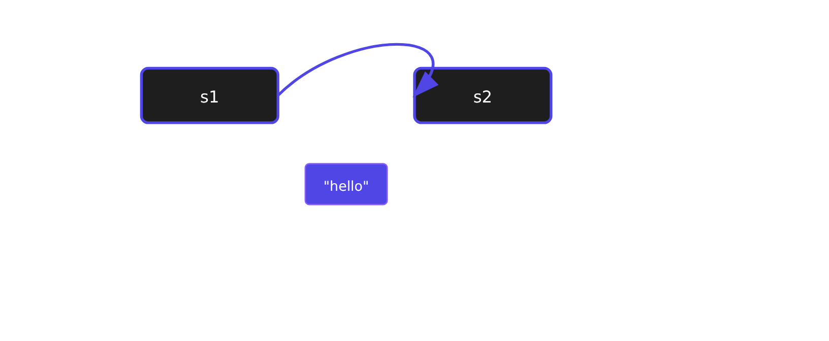


Case Study: Rust (1/2)
Strong, Static Typing
The Ownership System
Types checked rigorously at compile time
Prevents runtime errors by construction
No implicit type conversions
Memory Safety
Guarantees memory safety without a garbage collector
Eliminates null pointer dereferences
Prevents data races and use-after-free errors
// Ownership example
fn
main
() {
let
s1 =
String::from
(
"hello"
);
// s1 owns the data
let
s2 = s1;
// Ownership transferred
println!
(
"{}"
, s2);
// Valid
println!
(
"{}"
, s1);
// Compile-time ERROR
}
Rust
Python
JavaScript
Go

Slide 12







Case Study: Rust (2/2)
Rust Ownership Example
Key Points About Rust's Ownership
fn
main
() {
Move Semantics: When
// s1 owns the string data
let s1 = String::from("hello");
// Ownership of the string data is moved from s1 to s2
let s2 = s1;
// s2 now owns the data
println!("{}", s2); // Output: "hello"
// Error: s1 is no longer valid after ownership was moved
// println!("{}", s1); // COMPILE-TIME ERROR
}
Ownership Flow

Slide 13

















Exercises
Compare Static vs Dynamic Typing
Using Java and Python as examples, discuss the trade-offs in terms of:
Development speed and productivity
Runtime safety and error detection
Performance characteristics
int x = 10; /* Java */
x = "hello" /* Python */
Demonstrate Polymorphism
Provide code snippets for C++ and Haskell illustrating:
Parametric polymorphism (generics)
Ad-hoc polymorphism (overloading)
class Box<T> { T value; }
add(int a, int b) { return a + b; }
Research Question
Why are dependent types important in proving correctness of programs, particularly in safety-critical systems?
Consider how dependent types enable compile-time verification of properties that would otherwise require runtime checks or formal proofs.
C++
Submit your solutions as a single PDF document by the deadline
Java
Python
Haskell

